Slide 1
Introduction to Robotics Vision
Nikolaus Correll

Slide 2
Today
Perception using vision
Practical angle:
Why is vision hard
Basic image processing
How to combine image processing primitives into object recognition

Slide 3
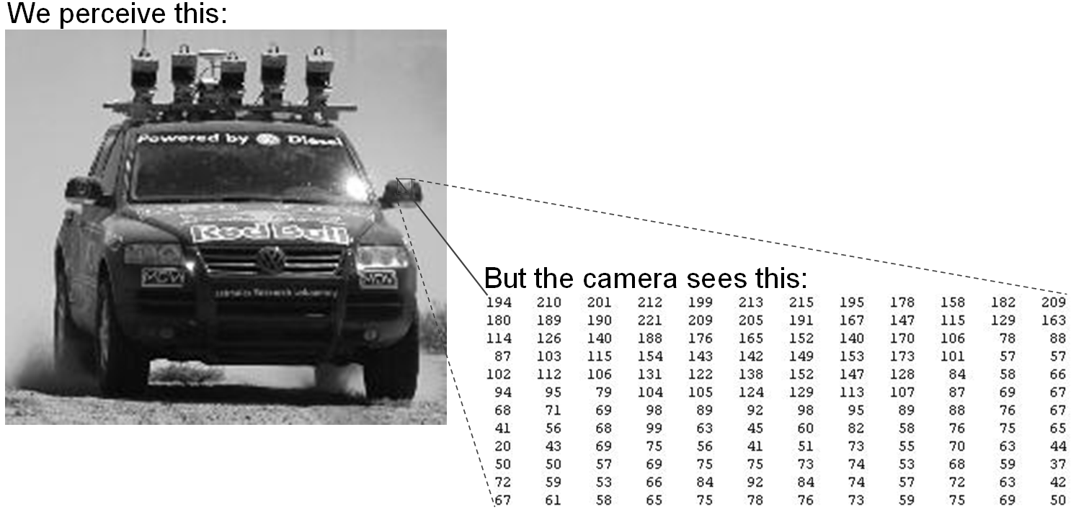
Why is Vision Hard? The difference between seeing and perception.
What to do?
Maybe we should try to find edges ….
Gary Bradski, 2005

Slide 4
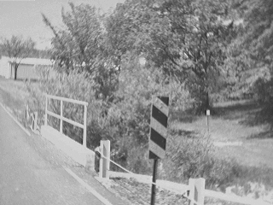
But, What’s an Edge?
Depth discontinuity
Surface orientation discontinuity
Reflectance discontinuity (i.e., change in surface material properties)
Illumination discontinuity (e.g., shadow)
Slide credit: Christopher Rasmussen

Slide 5
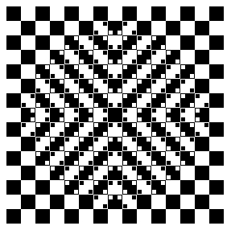
To Deal With the Confusion, Your Brain has Rules... That can be wrong

Slide 6
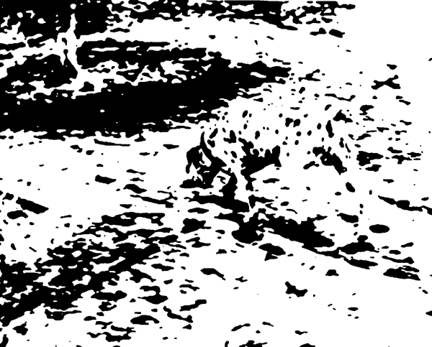
We even see invisible edges…

Slide 7
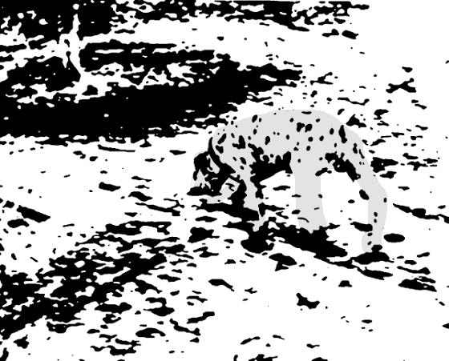
And surfaces …

Slide 8
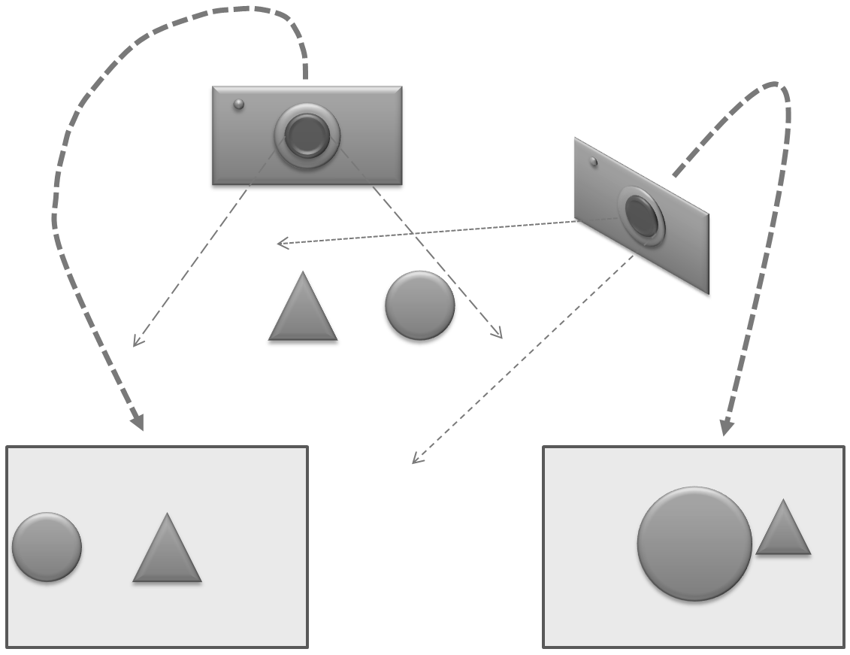
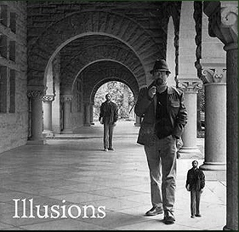
We need to deal with 3D Geometry
Perception is ambiguous … depending on your point of view!
Graphic by Gary Bradski

Slide 9
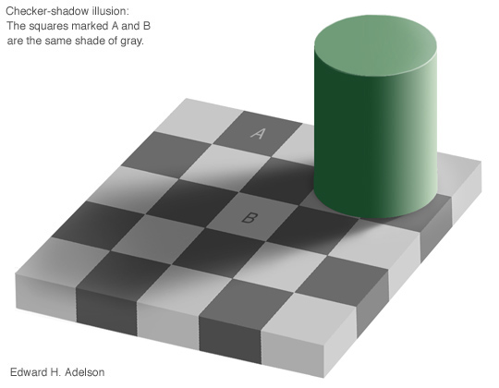
And Lighting in 3D
Which square is darker?

Slide 10
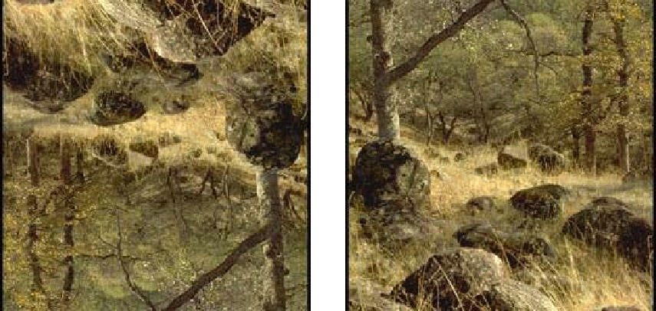
Lighting is Ill-posed …
Perception of surfaces depends on lighting assumptions
Gary Bradski (c) 2008
10

Slide 11
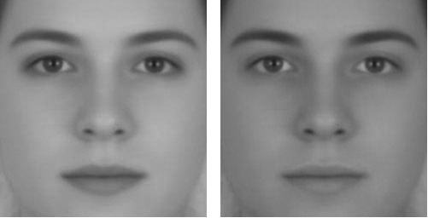
Contrast
Which one is male and which one is female?
Illusion by: Richard Russell, Harvard University
Russell, R. (2009) A sex difference in facial pigmentation and its exaggeration by cosmetics. Perception, (38)1211-1219

Slide 12
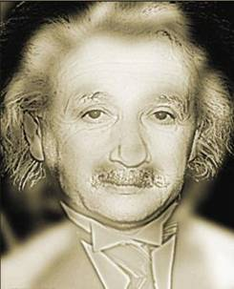
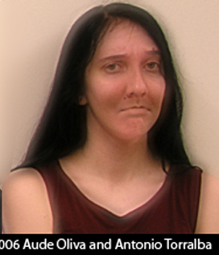
Frequency

Slide 13
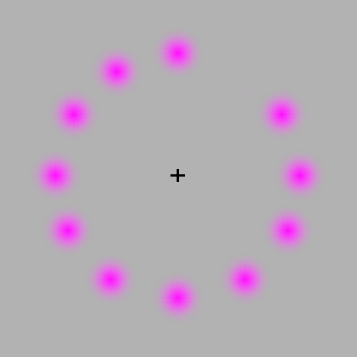
Color
http://briantobin.info/2009/06/lost-and-found-visual-illusion.html

Slide 14
Why are “optical tricks” interesting for Computer Vision

Slide 15
A lot of important information is hidden in low-level cues!

Slide 16
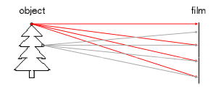
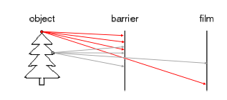
Pin-hole Model

Slide 17
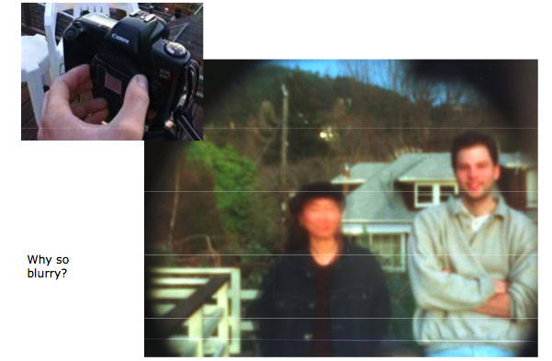
Pin-Hole Camera
A. Efros

Slide 18
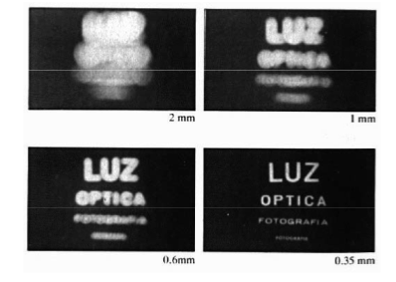
Aperture

Slide 19
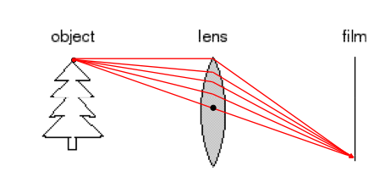
Increasing Aperture: Lens

Slide 20
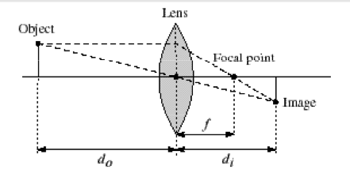
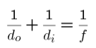
Thin Lens
Objects need to have the right distance to be in focus -> Depth-from-Focus method

Slide 21
Basic image operations

Slide 22


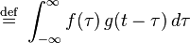
Convolution

Slide 23
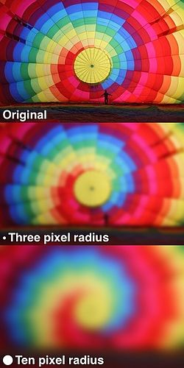
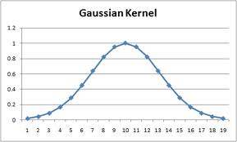
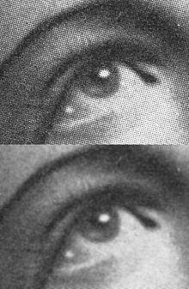
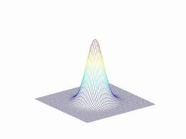
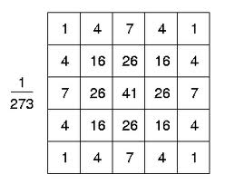
Gaussian Filter

Slide 24
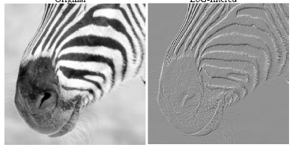
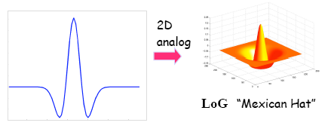
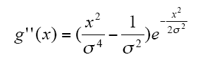
Sombrero function (Difference of Gaussians)

Slide 25
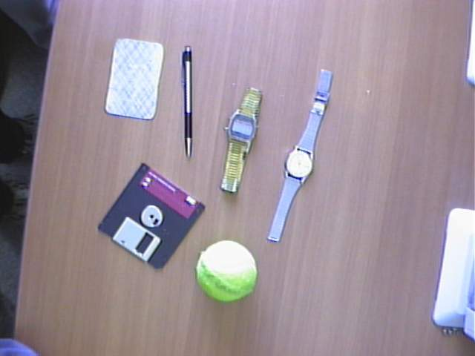
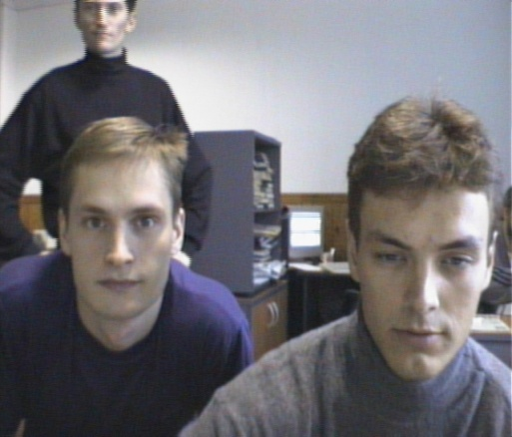
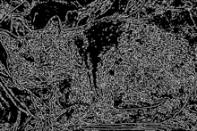
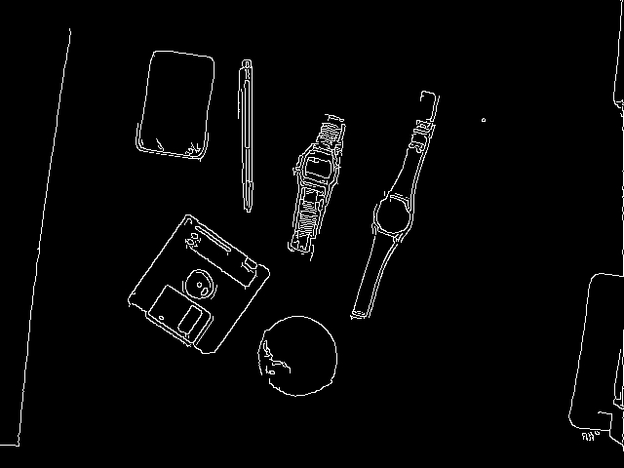
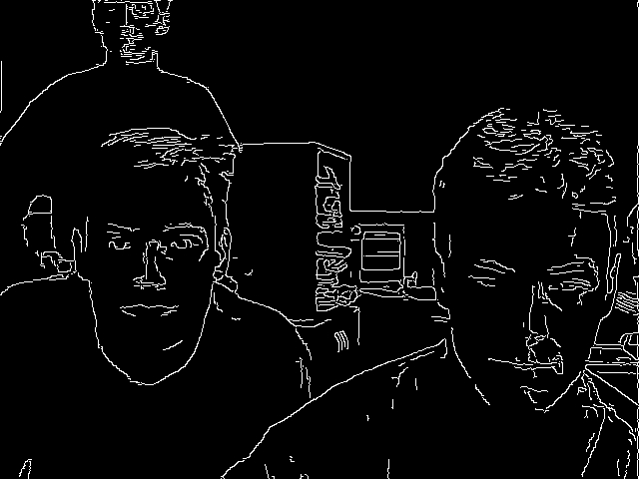
Canny Edge Detector
Gary Bradski (c) 2008
25
Notes:
25

Slide 26
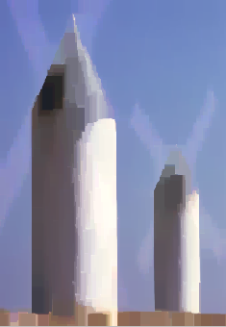
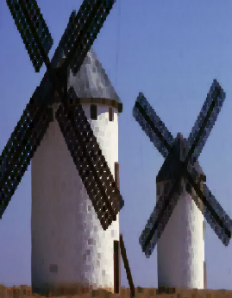
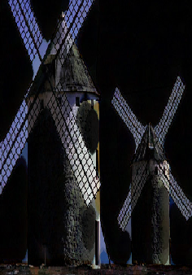
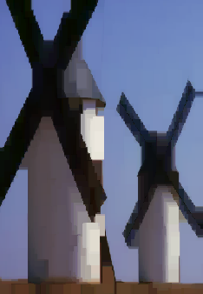
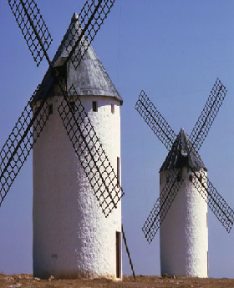
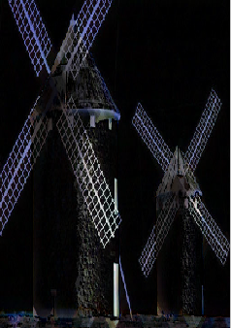
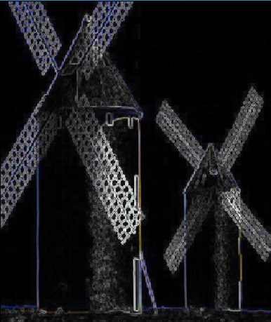
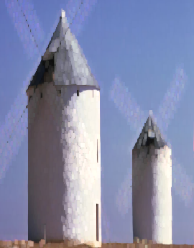
Morphological Operations Examples
Morphology - applying Min-Max. Filters and its combinations
Image I
Erosion IΘB
Dilatation I⊕B
Opening IoB= (IΘB)⊕B
Closing I•B= (I⊕B)ΘB
Grad(I)= (I⊕B)-(IΘB)
TopHat(I)= I - (IΘB)
BlackHat(I)= (I⊕B) - I

Slide 27
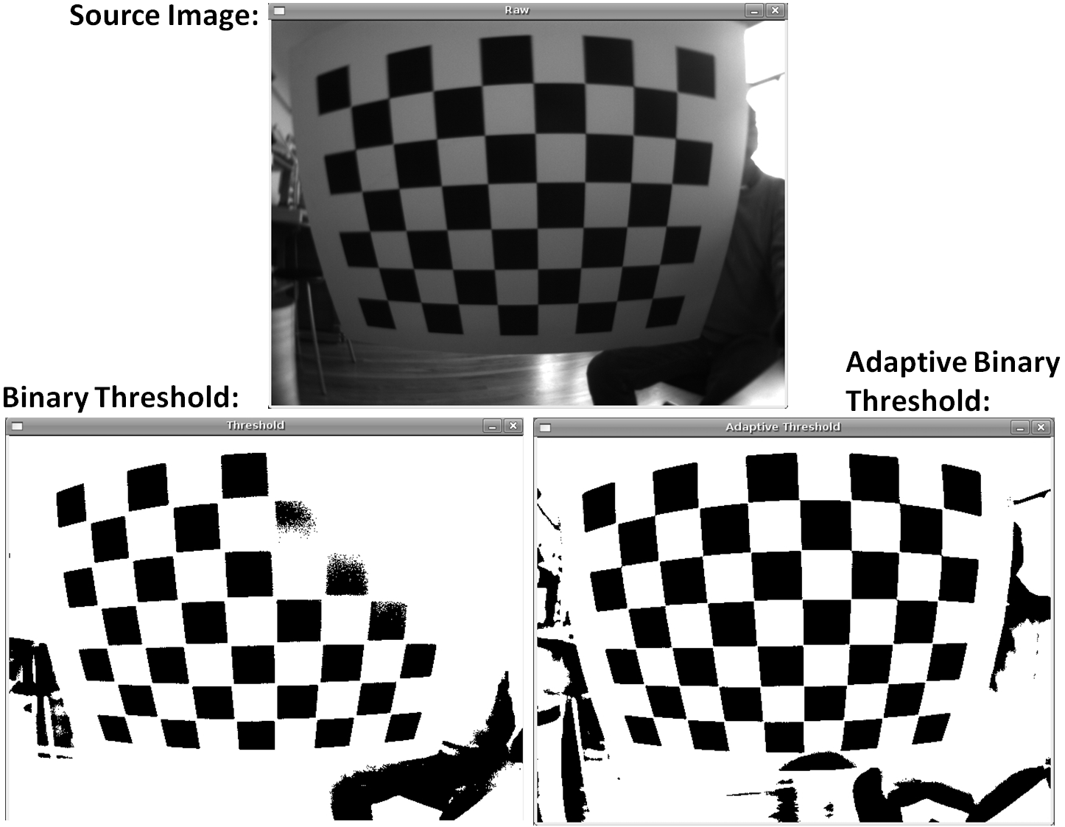
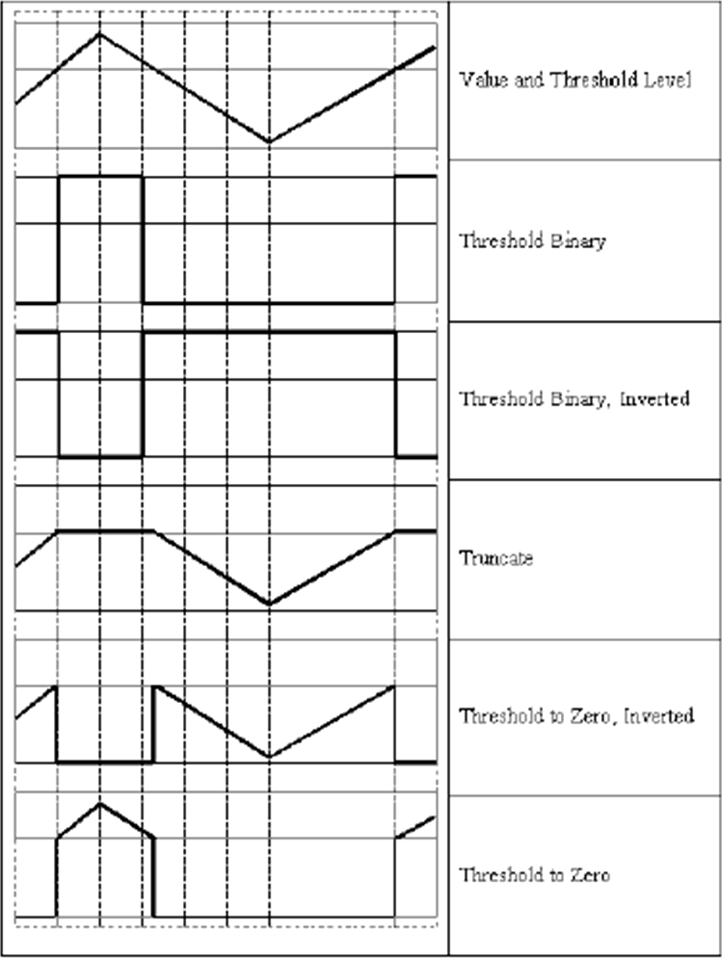
Thresholds
http://homepages.inf.ed.ac.uk/rbf/HIPR2/adpthrsh.htm
Screen shots by Gary Bradski, 2005
27

Slide 28
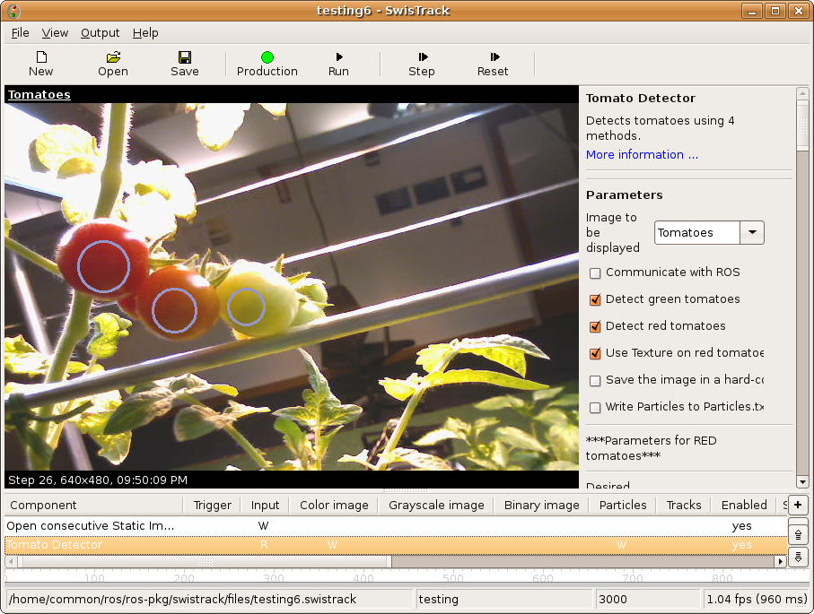
Example: Tomato-Picking Robot
Challenges
Foliage
Reflections
Varying size and shape
Varying color
Partly covered fruits
http://swistrack.sourceforge.net
N. Correll, N. Arechiga, A. Bolger, M. Bollini, B. Charrow, A. Clayton, F. Dominguez, K. Donahue, S. Dyar, L. Johnson, H. Liu, A. Patrikalakis, T. Robertson, J. Smith, D. Soltero, M. Tanner, L. White, D. Rus. Building a Distributed Robot Garden. In IEEE/RSJ International Conference on Intelligent Robots and Systems (IROS), pages 1509-1516, St. Louis, MO.

Slide 29

Filter-based object recognition
Filter image
Sobel
Hough transform
Color
Spectral highlights
Size and shape
Weighted sum of filters highlights object location
Sobel
Hough
Color
Spectral
Highlights

Slide 30
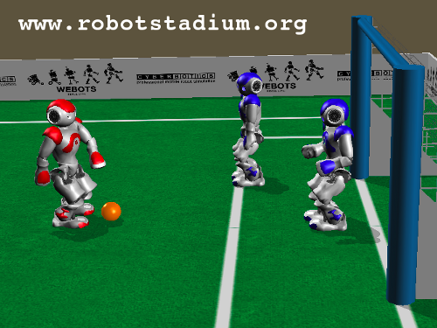
Group exercise
Object recognition
Goal
Players
Ball
Field

